Slide 1
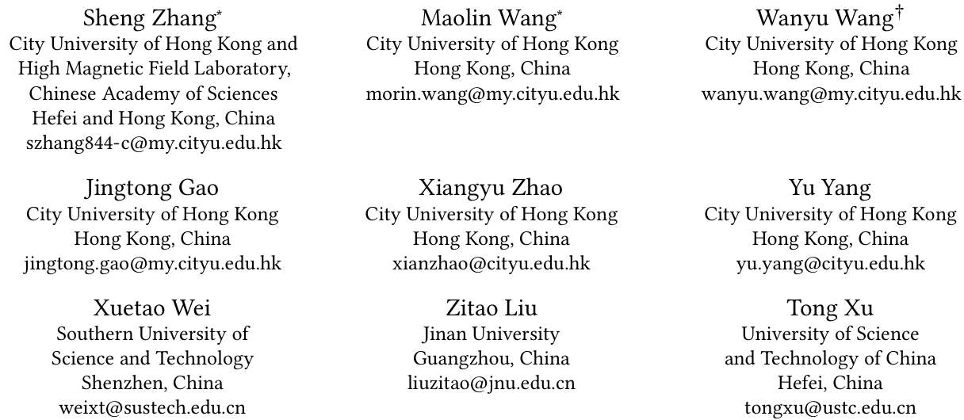
ATAI
Advanced Technique of Artificial Intelligence
ATAI
ChongqingUniversity _{AdvancedTechniqueof}
of Technology Artificial Intelligence
Chongqing University of
Technology
Chongqing University ^{ATAI}
_{of Technology} Advanced Techniqueof
Artificial Intelligence
Chongqing University of Technology
Chongqing University of Technology
GLINT-RU: Gated Lightweight Intelligent Recurrent Units for
Sequential Recommender Systems
szhang-cityu/GLINT-RU
——KDD_2025
Reported by Jinfei Chen
1

Slide 2
ATAI
Advanced Technique of Artificial Intelligence
ATAI
ChongqingUniversity _{AdvancedTechniqueof}
of Technology Artificial Intelligence
Chongqing University of
Technology
Chongqing University ^{ATAI}
_{of Technology} Advanced Techniqueof
Artificial Intelligence
Chongqing University of Technology
Chongqing University of Technology
Motivation
Transformer-based models often suf fer from high computational costs and slow inference.
Meanwhile, existing efficient SRS approaches struggle to embed high-quality semantic and positional information into latent representations.

Slide 3
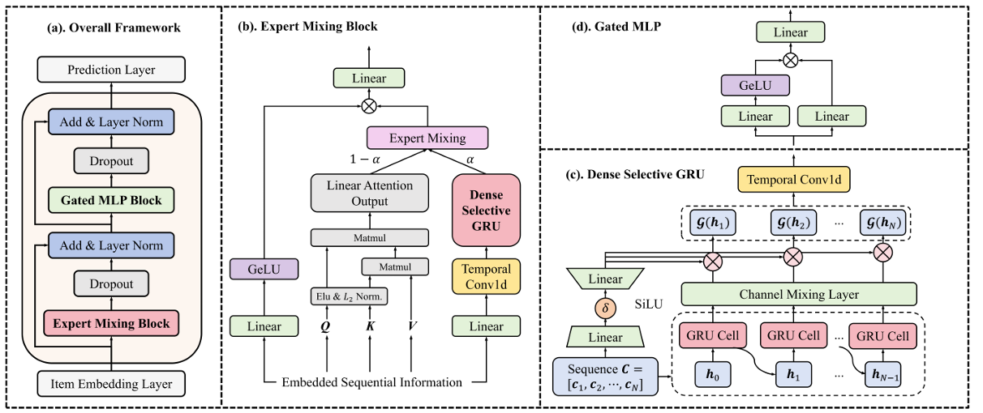
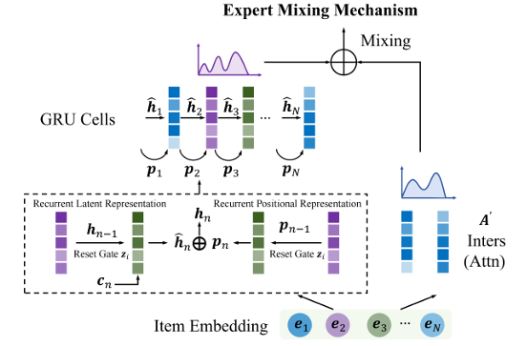
ATAI
Advanced Technique of Artificial Intelligence
ATAI
ChongqingUniversity _{AdvancedTechniqueof}
of Technology Artificial Intelligence
Chongqing University of
Technology
Chongqing University ^{ATAI}
_{of Technology} Advanced Techniqueof
Artificial Intelligence
Chongqing University of Technology
Chongqing University of Technology
Overview

Slide 4
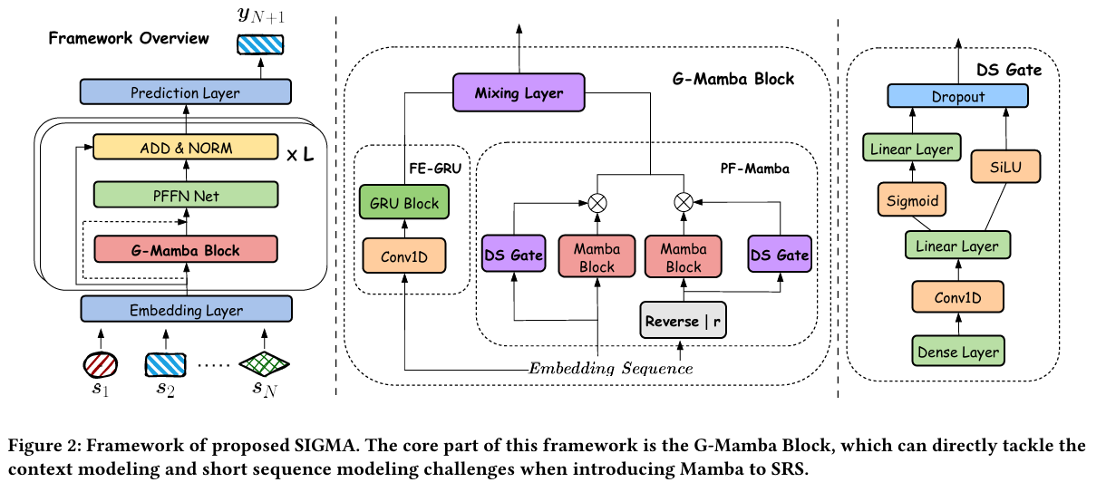
ATAI
Advanced Technique of Artificial Intelligence
ATAI
ChongqingUniversity _{AdvancedTechniqueof}
of Technology Artificial Intelligence
Chongqing University of
Technology
Chongqing University ^{ATAI}
_{of Technology} Advanced Techniqueof
Artificial Intelligence
Chongqing University of Technology
Chongqing University of Technology
Overview

Slide 5
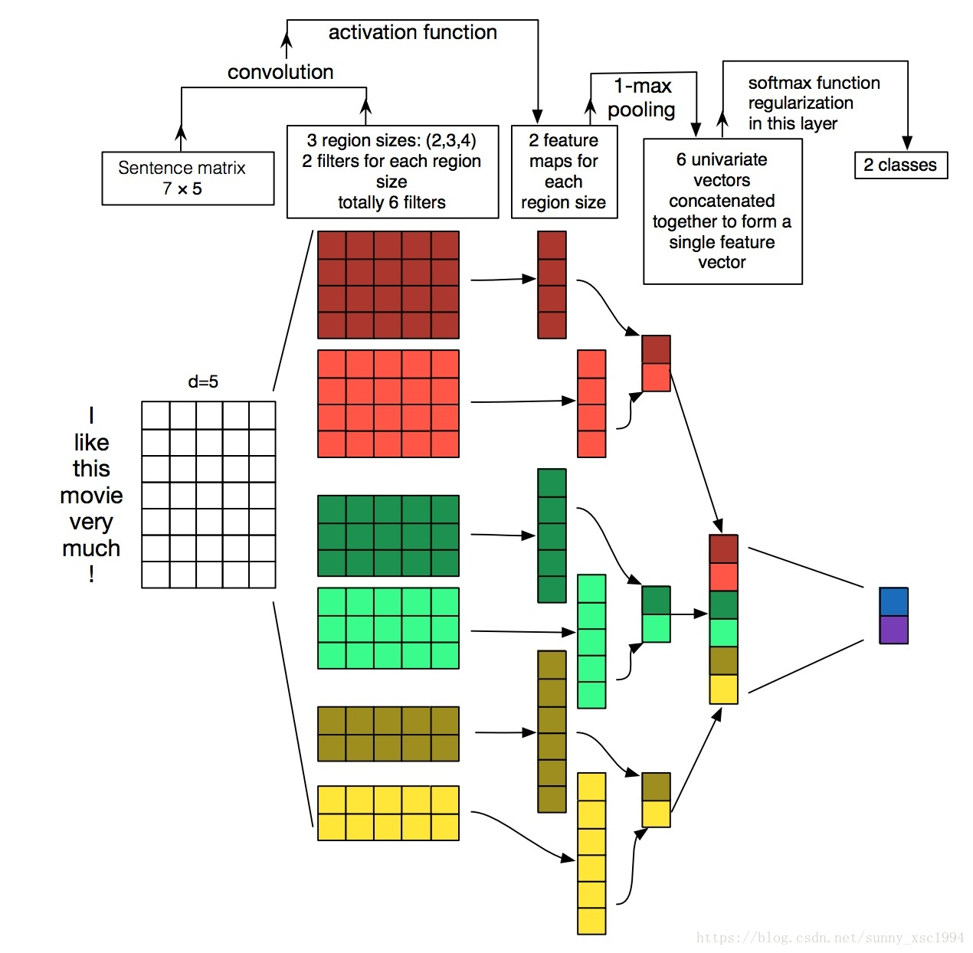
ATAI
Advanced Technique of Artificial Intelligence
ATAI
ChongqingUniversity _{AdvancedTechniqueof}
of Technology Artificial Intelligence
Chongqing University of
Technology
Chongqing University ^{ATAI}
_{of Technology} Advanced Techniqueof
Artificial Intelligence
Chongqing University of Technology
Chongqing University of Technology

Slide 6
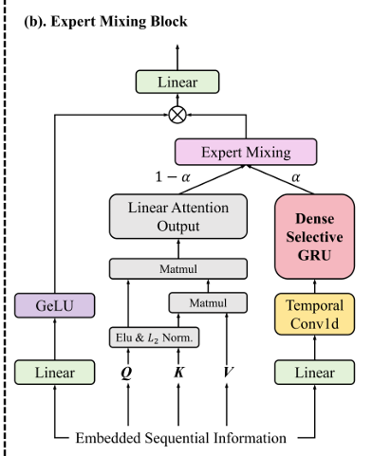
ATAI
Advanced Technique of Artificial Intelligence
ATAI
ChongqingUniversity _{AdvancedTechniqueof}
of Technology Artificial Intelligence
Chongqing University of
Technology
Chongqing University ^{ATAI}
_{of Technology} Advanced Techniqueof
Artificial Intelligence
Chongqing University of Technology
Chongqing University of Technology
Method

Slide 7
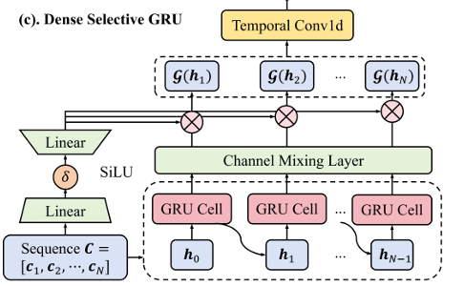
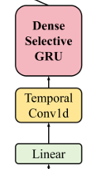
ATAI
Advanced Technique of Artificial Intelligence
ATAI
ChongqingUniversity _{AdvancedTechniqueof}
of Technology Artificial Intelligence
Chongqing University of
Technology
Chongqing University ^{ATAI}
_{of Technology} Advanced Techniqueof
Artificial Intelligence
Chongqing University of Technology
Chongqing University of Technology
Method

Slide 8
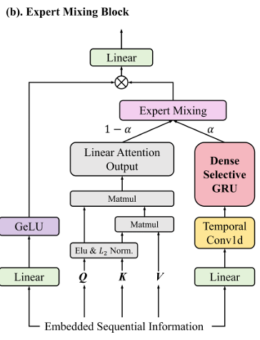
ATAI
Advanced Technique of Artificial Intelligence
ATAI
ChongqingUniversity _{AdvancedTechniqueof}
of Technology Artificial Intelligence
Chongqing University of
Technology
Chongqing University ^{ATAI}
_{of Technology} Advanced Techniqueof
Artificial Intelligence
Chongqing University of Technology
Chongqing University of Technology
Method

Slide 9
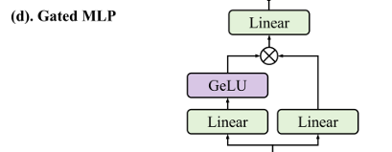
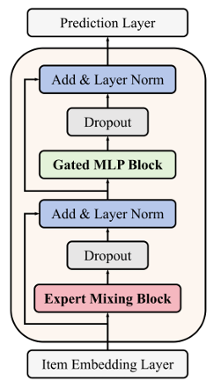
ATAI
Advanced Technique of Artificial Intelligence
ATAI
ChongqingUniversity _{AdvancedTechniqueof}
of Technology Artificial Intelligence
Chongqing University of
Technology
Chongqing University ^{ATAI}
_{of Technology} Advanced Techniqueof
Artificial Intelligence
Chongqing University of Technology
Chongqing University of Technology
Method

Slide 10
ATAI
Advanced Technique of Artificial Intelligence
ATAI
ChongqingUniversity _{AdvancedTechniqueof}
of Technology Artificial Intelligence
Chongqing University of
Technology
Chongqing University ^{ATAI}
_{of Technology} Advanced Techniqueof
Artificial Intelligence
Chongqing University of Technology
Chongqing University of Technology
Experiments

Slide 11
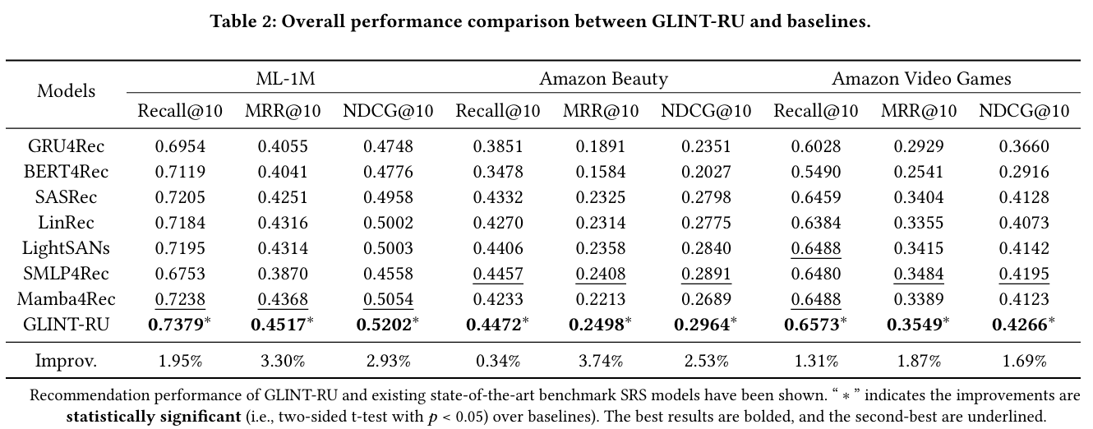
ATAI
Advanced Technique of Artificial Intelligence
ATAI
ChongqingUniversity _{AdvancedTechniqueof}
of Technology Artificial Intelligence
Chongqing University of
Technology
Chongqing University ^{ATAI}
_{of Technology} Advanced Techniqueof
Artificial Intelligence
Chongqing University of Technology
Chongqing University of Technology
Experiments

Slide 12
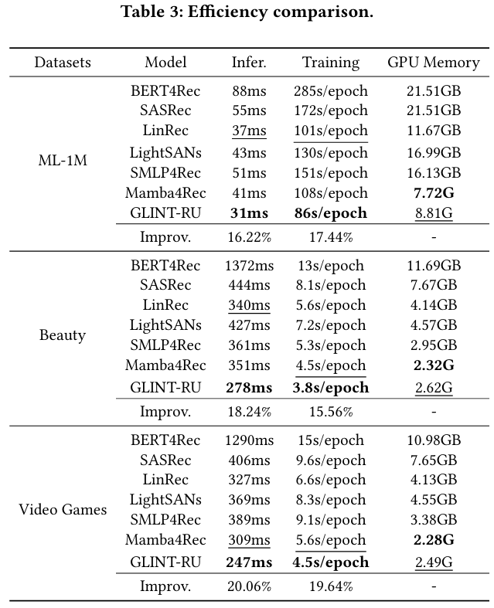
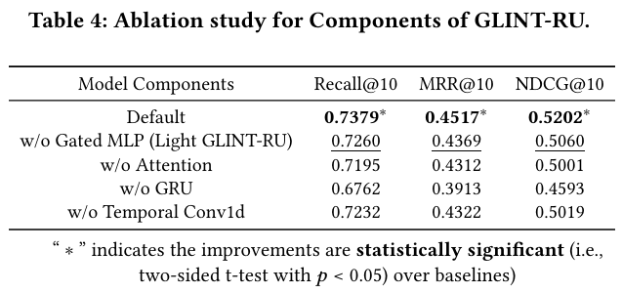
ATAI
Advanced Technique of Artificial Intelligence
ATAI
ChongqingUniversity _{AdvancedTechniqueof}
of Technology Artificial Intelligence
Chongqing University of
Technology
Chongqing University ^{ATAI}
_{of Technology} Advanced Techniqueof
Artificial Intelligence
Chongqing University of Technology
Chongqing University of Technology
Experiments

Slide 13
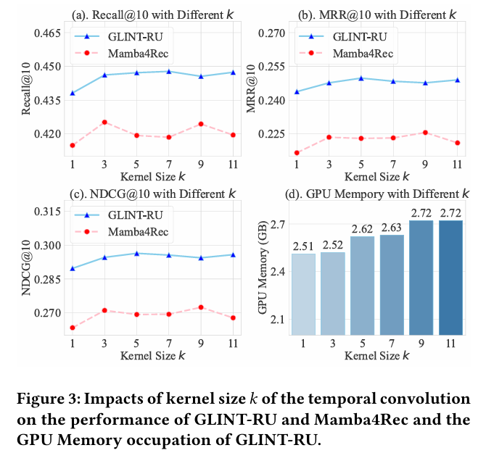
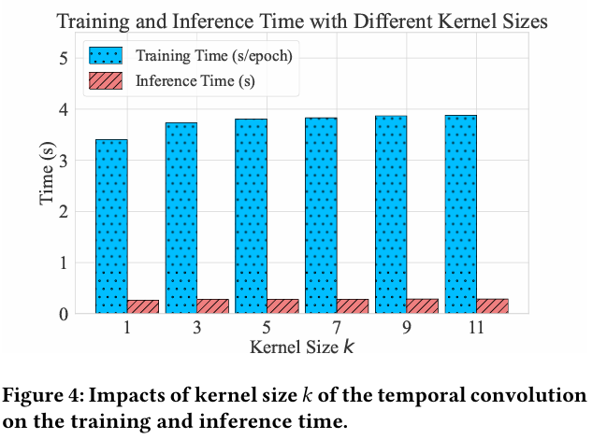
ATAI
Advanced Technique of Artificial Intelligence
ATAI
ChongqingUniversity _{AdvancedTechniqueof}
of Technology Artificial Intelligence
Chongqing University of
Technology
Chongqing University ^{ATAI}
_{of Technology} Advanced Techniqueof
Artificial Intelligence
Chongqing University of Technology
Chongqing University of Technology
Experiments

Slide 14
ATAI
Advanced Technique of Artificial Intelligence
ATAI
ChongqingUniversity _{AdvancedTechniqueof}
of Technology Artificial Intelligence
Chongqing University of
Technology
Chongqing University ^{ATAI}
_{of Technology} Advanced Techniqueof
Artificial Intelligence
Chongqing University of Technology
Chongqing University of Technology
Experiments

Slide 15
ATAI
Advanced Technique of Artificial Intelligence
ATAI
ChongqingUniversity _{AdvancedTechniqueof}
of Technology Artificial Intelligence
Chongqing University of
Technology
Chongqing University ^{ATAI}
_{of Technology} Advanced Techniqueof
Artificial Intelligence
Chongqing University of Technology
Chongqing University of Technology
Thanks!

